Slide 1
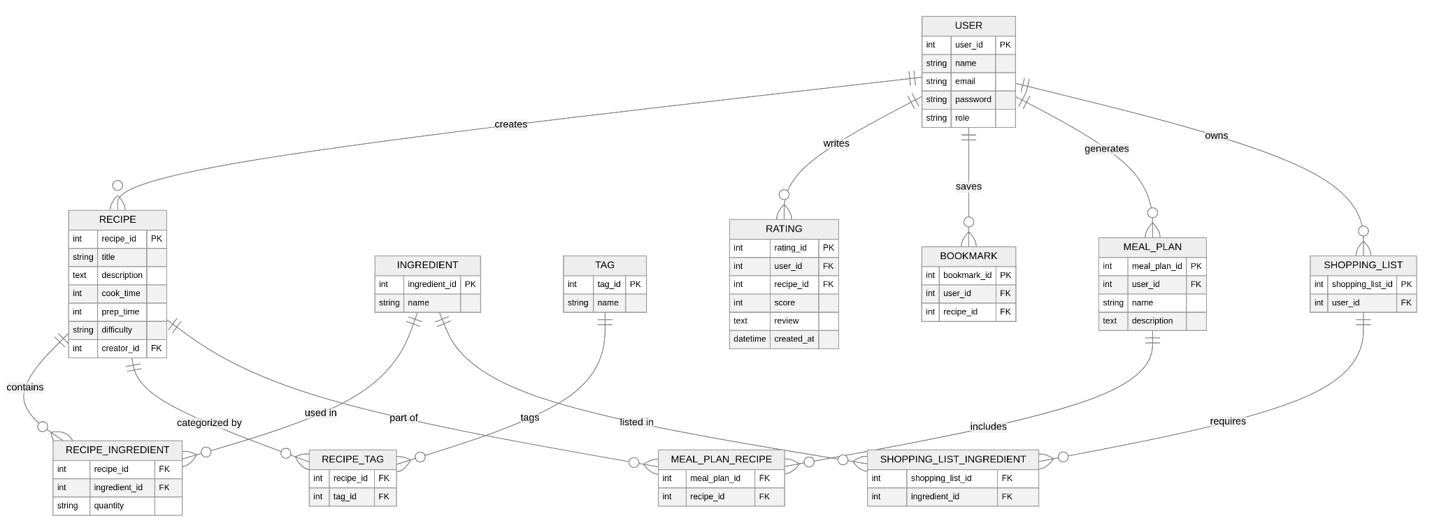
CookAtlas
Alek Breitenbach, Ethan Twombly, Jack Moore, Josh Lee, Lukyan Sukhachevskyi

Slide 2
Main Idea
Centralized tagging system for recipes that aggregates content from external sources like Youtube, blogs, Social media, etc.
Can search recipes based on attributes like prep time, cook time, ingredients, skills level, and dietary restrictions

Slide 3
Target Users
Casual User
Not much time on their hands for extensive cooking
Prefer cheap, relatively simple & easy meals
Focus on efficiency, leverage bookmarking & favorites
Culinary Enthusiast
Lots of experience cooking
More interactive with the platform
Rates and reviews others content

Slide 4
Target Users
Blogger / Content Creator
Creates recipes, tutorials to share
Writes reviews and rates others content
Create a creator profile to advertise their own personal recipes, socials
Health and Fitness Enthusiast
Customize meals to reach certain health goals with filters
Read detailed nutritional information
Follow other health-focus content creators

Slide 5
Core Features
Recipe Search by Tags (filter by time, difficulty, ingredients, etc.)
User Ratings & Reviews (community-driven recommendations)
Bookmarking & Favorites (save and revisit)

Slide 6
Core Features
Dietary & Allergen Filters (custom health-conscious choices)
Shopping List Generator (plan meals based on owned ingredients)
Meal Planning Assistant (help create personalized meal plans)

Slide 7
Questions?

